Slide 1
Location Based Demand Prediction for the NYC Ride Sharing And Taxi Market
Big Data Systems & Analytics
Feng Xiao, Marcel Gwerder, Xiaoying Ji, Andrew Jo,
Notes:
Andrew

Slide 2
Agenda
* Background * Goals * Proposed Concept * Datasets * Data Processing * Modeling * Evaluation of Results * Architecture * User Interface * Summary * Lessons Learned * Q&A
Notes:
Andrew

Slide 3
Background
* Ride Sharing and Taxi Market
World’s Taxi Market Value currently valued >$100 billion and is highly fragmented
Ride Sharing, leading as a major building block of the “sharing economy” - Exponential growth in recent years: 1. Over 1.5 million drivers and 42 million passengers, and 2 billion annual rides. 2. Uber’s expected IPO of $120B in 2019 (more than Ford, GM, and Chrysler combined)
* Pain points - Unpredictable wait time and fare income - Nonoptimal supply and demand
Notes:
Ride Sharing and Taxi Market:
Example: New York saw approximately up to 25 million unique rides per month in 2017, consisting of 15 million ride share and 10 million taxi rides.

Slide 4
Goals and Plan of Activity
* Innovations * Provide an option for the companies to be proactive * Risks * Internal goals and distribution for the project:
Levels | Details | Note/Deadline
Level 0 | Data Visualization/UI | 11/11/2018
Level 1 | Prediction | 11/29/2018
Level 2 | Utilize additional variables | Realistic Goal
Level 3 | Additional predictions | Reach Goal
Notes:
Andrew
Level 0: data queries/repeating what the link did – data visualization/UI (absolute minimum)
Level 1: given region and timestamp, a prediction of customer density (realistic minimum)
Level 2: level 1 + weather + trip duration (goal)
Level 3: driver-location based predication(distance to regions) (reach)
Innovation
Risks include data privacy, incorrect predictions/recommendations, and not meeting the internal deadlines. In order to maximize our likelihood of success, I will be partnering with Marcel to tackle Model Training while Xiao and Feng will handle Visualization. We will continue have a group meeting twice a week to ensure that the entire group is up to speed on the progress. However, more platform traffic will increase potential for selling services to companies.
Show the existing solution based on filtering and how our solution improves upon that one
https://nycdatascience.com/blog/student-works/uber-optimization-finding-passengers-faster/

Slide 5
Proposed Concept
Grid-based Model Training
Dividing the minimum square containing NYC into 30*30 grids
Mapping coordinates of the data to the corresponding region
Aggregating data in the same region
Train and store the model in Cloud
Prediction
Input: timestamp, weather, location
Output: predicted number of customers in each region
Heatmap
Heatmap color depending on demands prediction in the selected day
The user pick up a day in the future
Notes:
Show Idea with grid-based prediction and what kind of data we need in order to train a model and get a prediction.

Slide 6
Datasets
Uber Pickups in NYC
Source: Kaggle
4.5 million Uber pickups from 2014
Date/time, Latitude, Longitude(Pick up & drop off)
Taxi & Limousine Trip Data in NYC
Source: NYC Taxi & Limousine Commission
165 million data from 2014
(Level 2) Weather Data
Source: Weather.com
Temperature(in hour), precipitation(rain, snow)...
Notes:
http://www.nyc.gov/html/tlc/html/about/trip_record_data.shtml (Only use data in the same timeframe as the kaggle data)
https://www.kaggle.com/fivethirtyeight/uber-pickups-in-new-york-city/
https://api.weather.com/v1/geocode/40.77000046/-73.98000336/observations/historical.json
Include some stats of the datasets (how many data points, how big in total, time range etc.)
Show the first few lines of each set

Slide 7
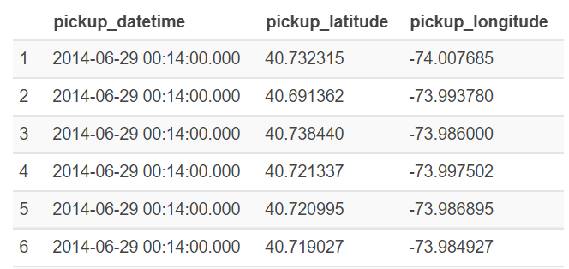
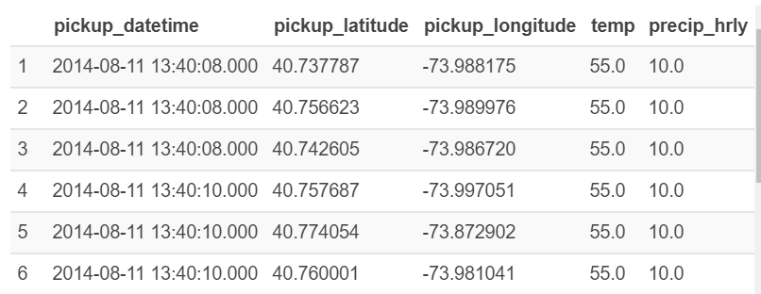
Data Processing
Used Amazon Athena to handle size of the datasets (~24GB, 165 mio rows)
Combine rides with historical hourly weather data
Remove erroneous data points (e.g. out of range lat/long)
Notes:
In order to be able to train a model and make future predictions about the location psecific demand, we needed to preprocess our data accordingly.
The 2014 taxi dataset is relatively big and therefore we decided to use Amazon Athena to process our data. Amazon Athena is a managed service that uses prestodb and allows you to easily query data on Amazon S3 using SQL.
There were 4 steps necessary to get to a dataset that we can use for demand prediction:
We needed to enrich our ride data with the historical weather information gathered from the weather.com api. In order to do that we created two tables in Athena containing the two datasets and then joined the two together using SQL.
Clean the data, respectively remove erroneous data points

Slide 8
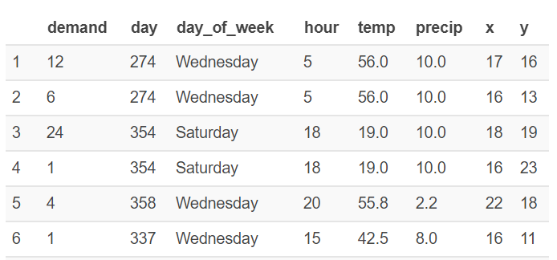
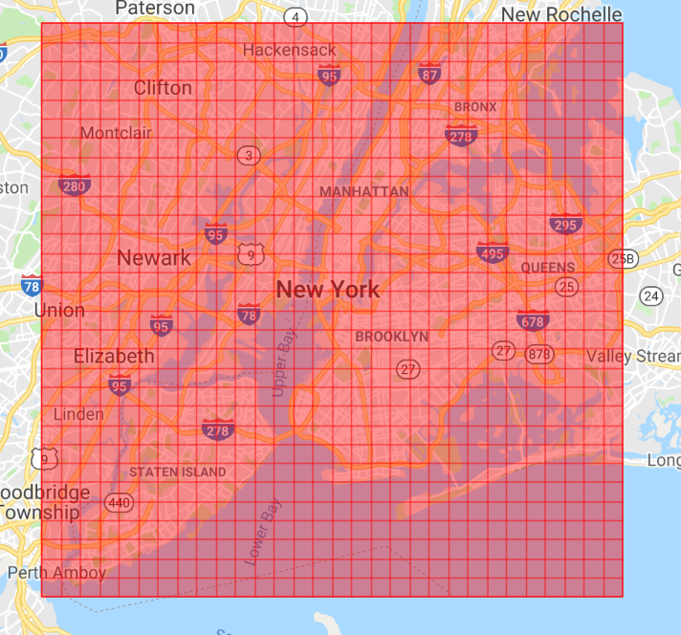
Data Processing
Map the pickup location to the respective tile in the grid
Aggregate data to get the demand for every tile and every hour of the year
Notes:
3. The longitude/latitude information needs to be translated to the coordinates of a specific tile in the created grid. We used another join that links the two rows where the longitude/latitude fall within the boundaries of the tile.
4. The final step is to aggregate the data in order to have the number of pickups per hour and tile.
Obvious measurement errors for longitude and latitude are eliminated automatically because they do not fall within the boundaries of the defined grid.
The resulting dataset consists of about 1 mio rows and is ready to be used in the next project phase, the modelling. We now have the historical demand data for each tile in our grid and can try to find the best model for the job.

Slide 9

Modeling
Train model that predicts demand for specific tile at given time in the future
Alternative is the classification into low/medium/high demand
Derive reasonable predictors from limited input given e.g. day of week from date/time.
Promising options include (continuous response / non-linear relationship)
Regression Trees / Random Forest
Deep Neural Network
Notes:
So far, we have finished the data preparation step which gives us the necessary dataset to start the modelling process.
The idea is to predict a continuous response for the demand. However, using classification as an alternative and produce labels for each tile such as high/medium/low demand is an option which could be considered.
Since the demand and our predictors are not in a linear relationship, we need an appropriate model to deal with this circumstance. Options we will explore in the next weeks include regression trees / random forest and also deep neural networks. A big part of the rest of our work will be spent on finding the best model for prediction and to hypertune it accordingly.

Slide 10
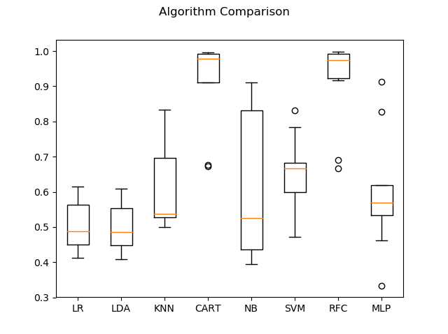
Modeling - Comparison of Algorithms
Used 40K rows of data with 6 inputs and 1 output (demand) classified into 1 or 0, depending on where they fall in the mean for the hour and the day. Decided to use Random Forest due to its overall reliable accuracy and speed.
Models | Mean | Standard Dev. | Time (s)
Logistic Regression (LR) | 5.1% | 7.15 | 1.29
Linear Discriminant Analysis (LDA) | 50.1% | 7.08 | 0.28
K Neighbors Classifier (KNN) | 61.1% | 11.68 | 0.69
Decision Tree Classifier (CART) | 91.1% | 12.15 | 0.79
GaussianNB (NB) | 61.2% | 20.13 | 0.12
Support Vector Classifier (SVM) | 65.7% | 9.93 | 1601.33
Random Forest Classifier (RFC) | 91.4% | 12.07 | 2.28
Multilayer Perceptron (MLP) | 60.0% | 15.80 | 32.22
Average | 60.7% | 12.00 | 204.88

Slide 11
Modeling - Hyperparameter Tuning
Once we have decided to use Random Forest Regressor, we tuned hyperparameters and compared against base parameters of 20 trees and 15 levels.
Even after increasing number of trees to 200 and depth to 40, the overall accuracy of the model only increased from 60.71% to 61.17%, while taking exponentially longer time to calculate, so we decided to stay with the base parameters for the project.
random forest tuning:
Best parameters: {'n_estimators': 200, 'min_samples_split': 2, 'min_samples_leaf': 1, 'max_features': 'auto', 'max_depth': 40, 'bootstrap': True}
Best score: 0.985177877164777
(Base) Model Performance
Average Error: 15.8474 degrees.
Accuracy = 60.71%.
(Tuned) Model Performance
Average Error: 15.4759 degrees.
Accuracy = 61.17%.
Testing Accuracy % Change of 0.75% from 60.71% to 61.17% (change of 0.46%).

Slide 12
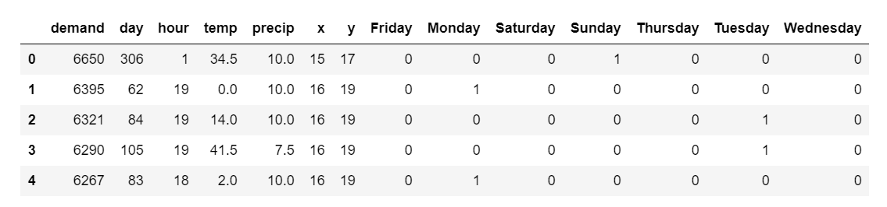
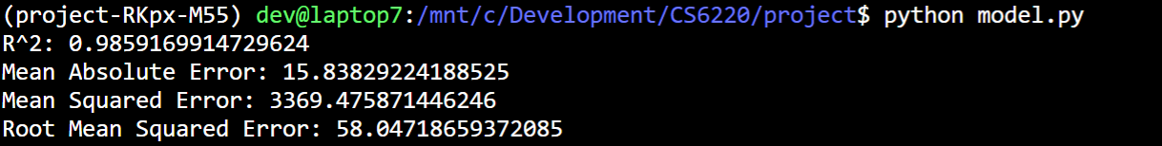
Modeling - Random Forest
A first test using a random forest with regression trees gives an R^2 of ~0.985
Adding predictors one by one shows that the x,y combination has by far the biggest impact followed by the day_of_week dummy variables and hour
Notes:
We will compare different models containing a different subset of predictors and do cross validation to determine the best model. Additionally we will try to make a prediction using deep learning and compare that as well.

Slide 13
Evaluation of Results
Aggregated data still consists of ~1 mio data points which provides flexibility when spitting into training, validation and test datasets
Comparison of Algorithms: Given the 40k rows of data (~4% of the aggregated data), quickly came to conclusion that decision tree and random forest are the only viable options, as other algorithms are unreliable (overall accuracy and standard deviation), time consuming, or both. When fed with the entire aggregated data, random forest was the superior algorithm due to the complexity and size of the data.
Hyperparameter Tuning: Randomly conducted 100 different combinations with 10 number of folds for cross validation each from a wide range of provided parameter grid, and came to conclusion that exponentially increasing the number of trees and levels resulted in slight improvements in prediction accuracy. We have thus decided to stay with the base parameters to optimize performance vs running time trade-offs.
High R^2 indicates a high prediction accuracy but there could also be a problem in the model (needs further investigation)
Required prediction accuracy is subject to end-user perception
Used visualization end results to gauge the expected demands from the Random Forest model on an hourly an daily basis
Notes:
In order to evaluate our results, we will split our dataset into training, validation and test sets. The aggregated data still consists of about 1 mio data points which gives us enough flexibility.
The general goal is to achieve an accuracy that makes our application valuable for the end-user.

Slide 14
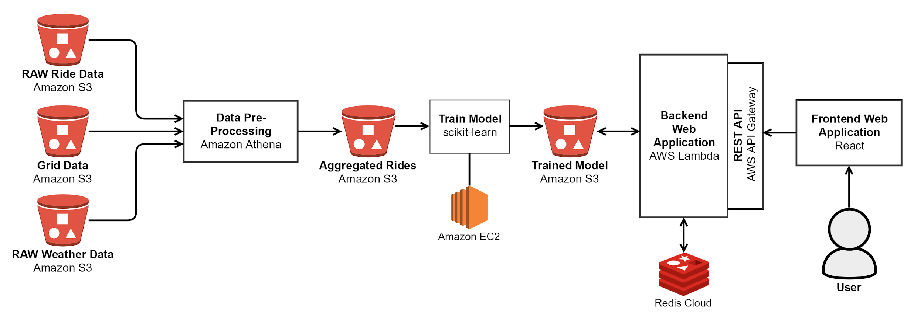
Architecture
Notes:
We store our raw data in Amazon S3, use Amazon Athena to join, clean and aggregate the data. We train a model on the aggregated data as discussed before, persist the model in S3 again.
To do: backend application.
For our web application we use a so called serverless architecture with AWS Lambda providing an interface to our trained model in order to do the predictions with the user input.
Feng Xiao

Slide 15
Architecture - Main Components
Data Storage
Amazon S3 for raw data and processed data
Redis for caching prediction results
Data Processing
Amazon Athena for processing the raw data using SQL
Prediction API
AWS Lambda and AWS API Gateway to create a low cost, highly scalable prediction API
Frontend
React web application which allows the user to select a time up to seven days into the future and see a heatmap based on the predictions made by the model.

Slide 16
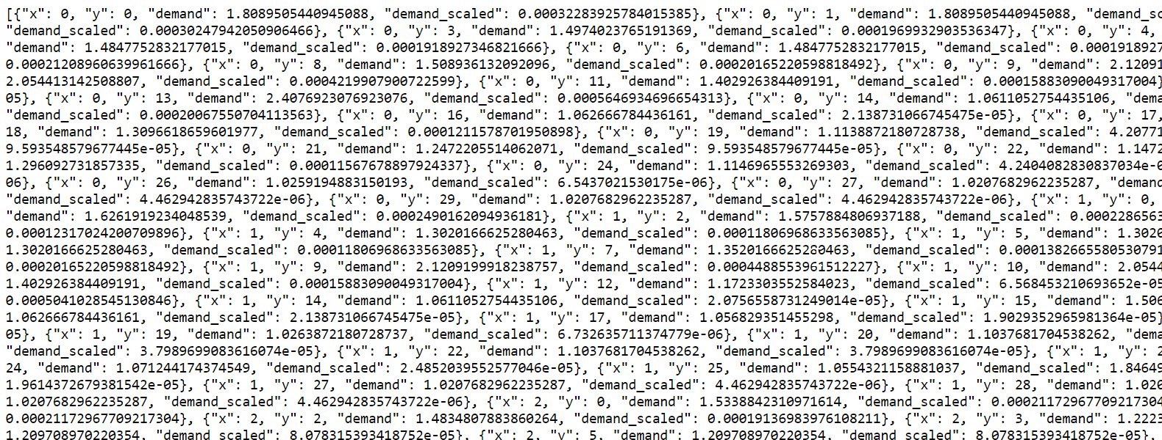
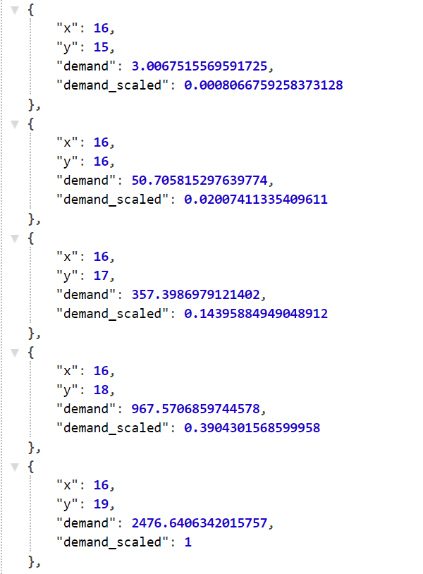
Prediction API - Example Prediction
https://owtjarn4j7.execute-api.us-east-1.amazonaws.com/prod/rides?date=2018-12-10&hour=16

Slide 17
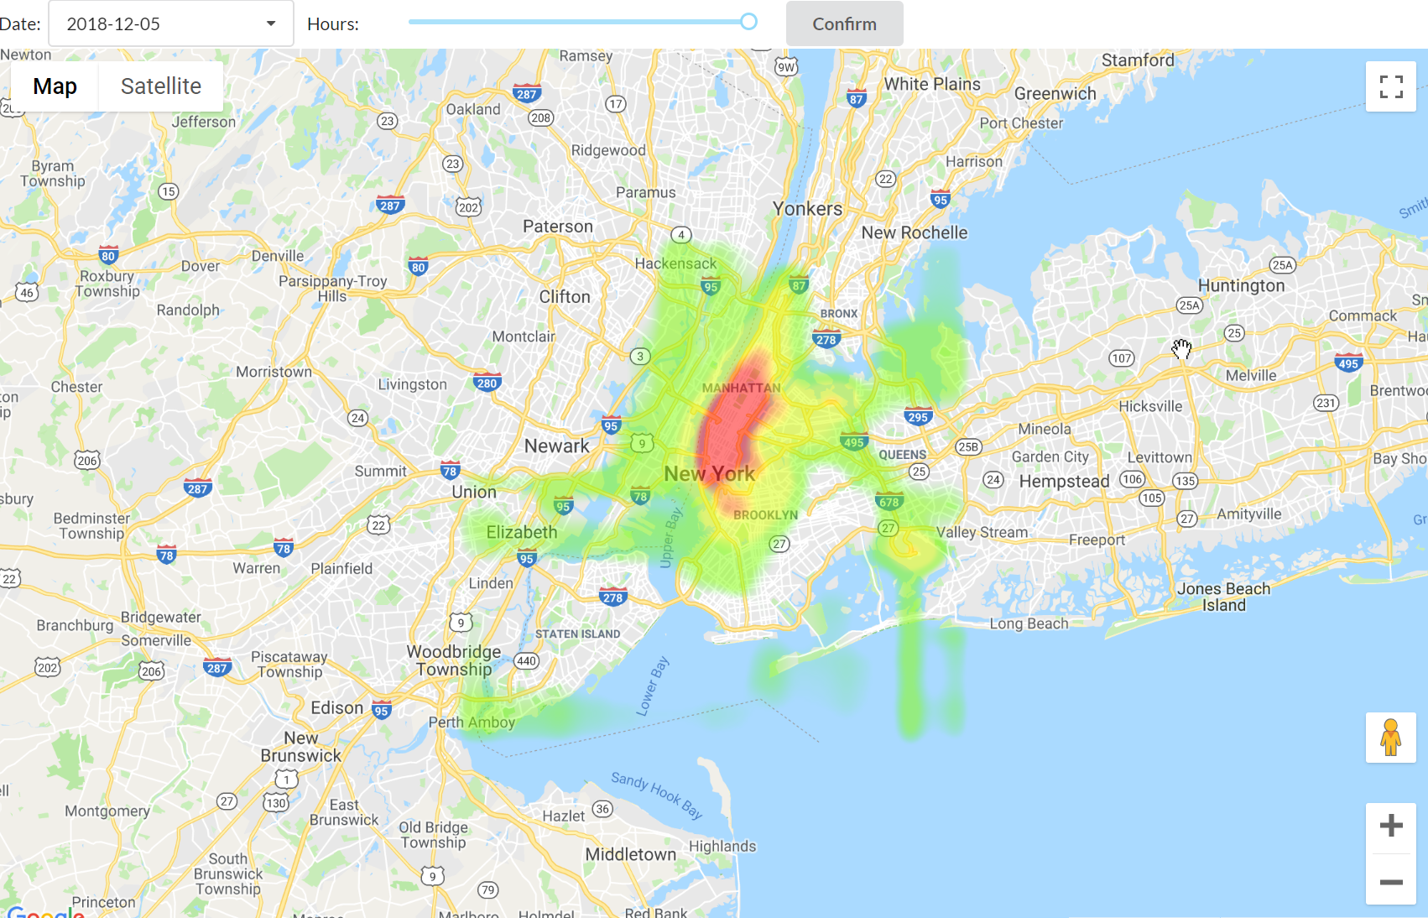
UI

Slide 18
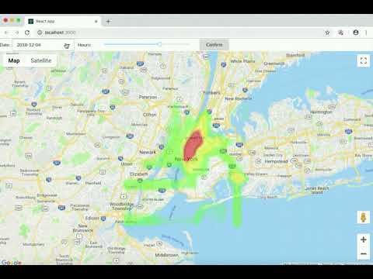

Slide 19
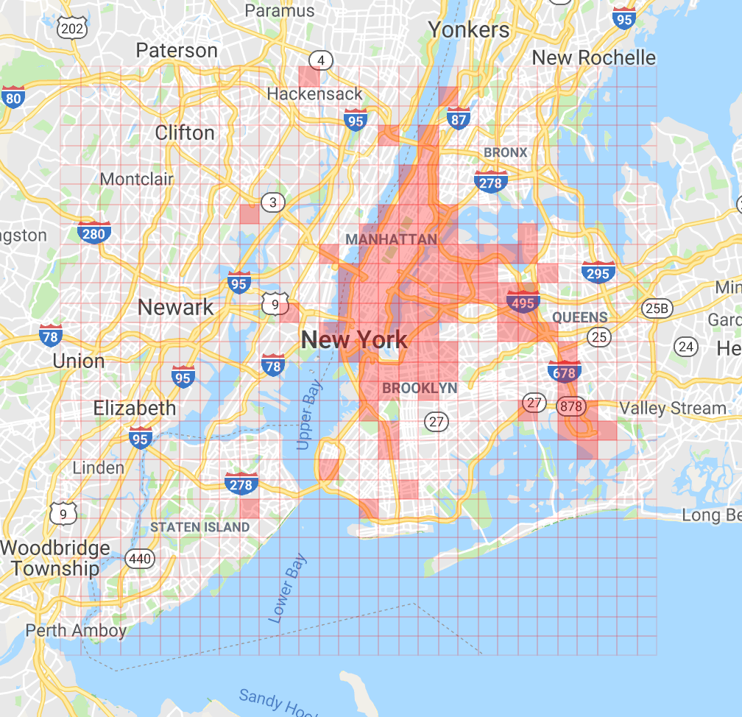
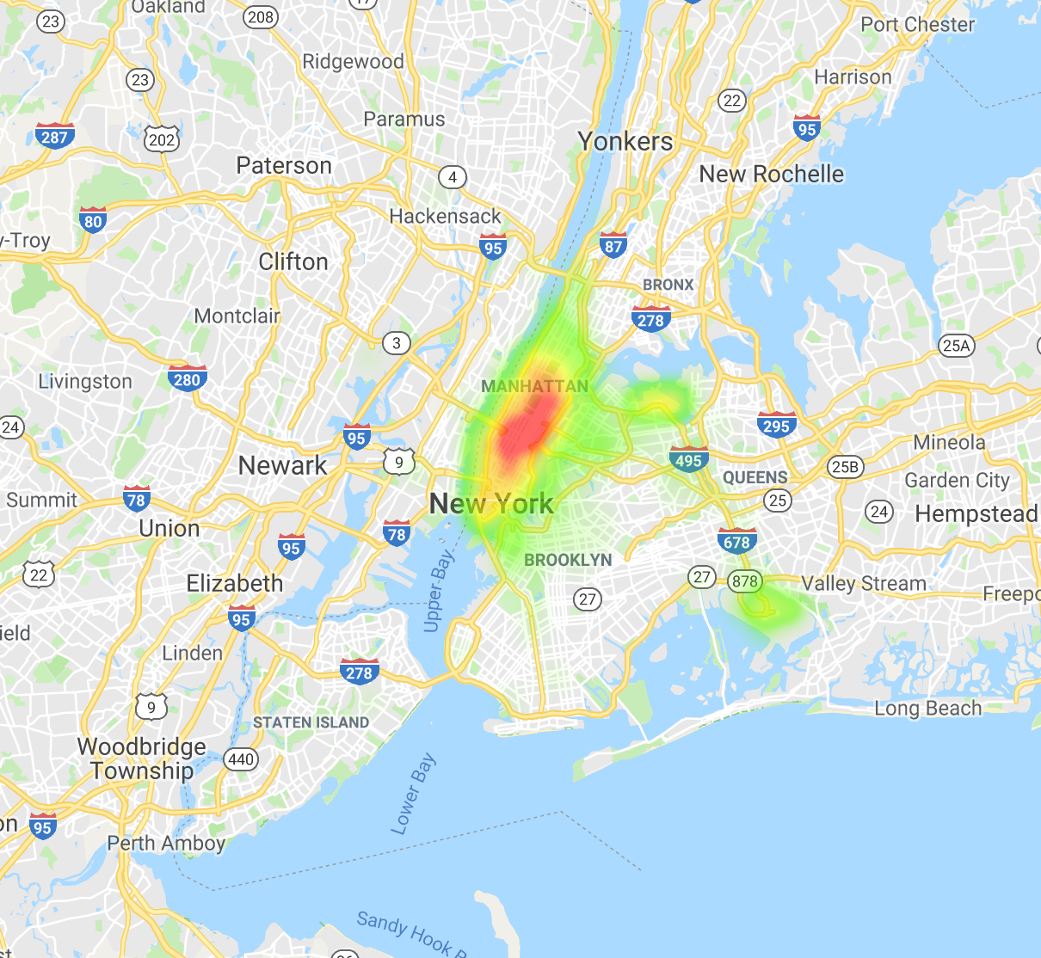
Heatmap of NYC taxi pickup At 12:00pm-1:00pm
.
Notes:
Screen shots/forms Feng.
1. Enter date and get the response for the whole day. 2. Sliding scale for 24 hours. 3. Enter current or future date
Use data of day300 hour12.
Q&A

Slide 20
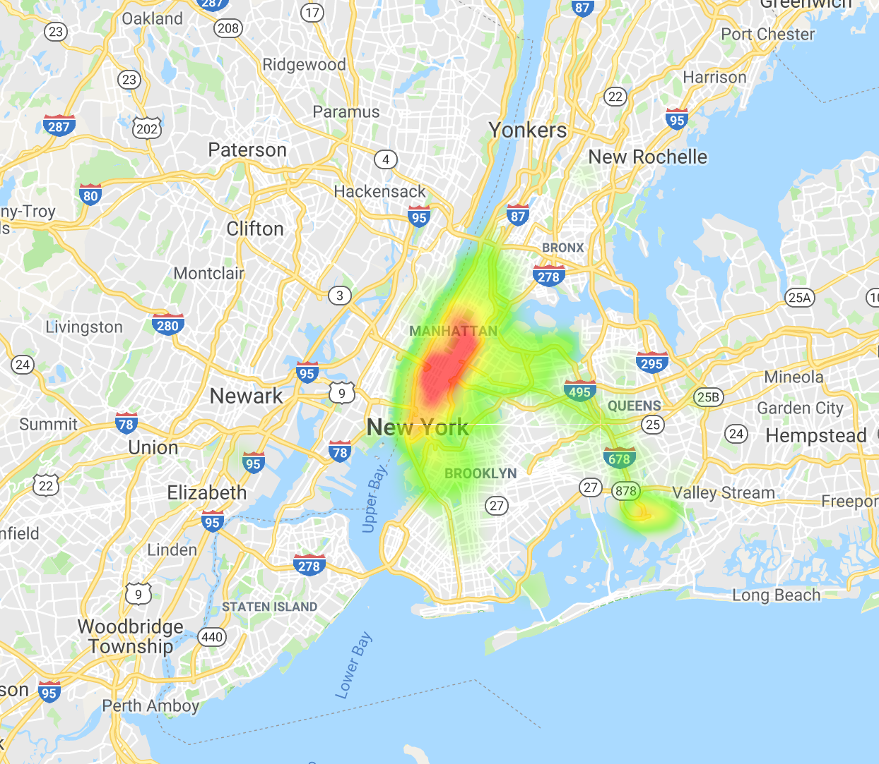
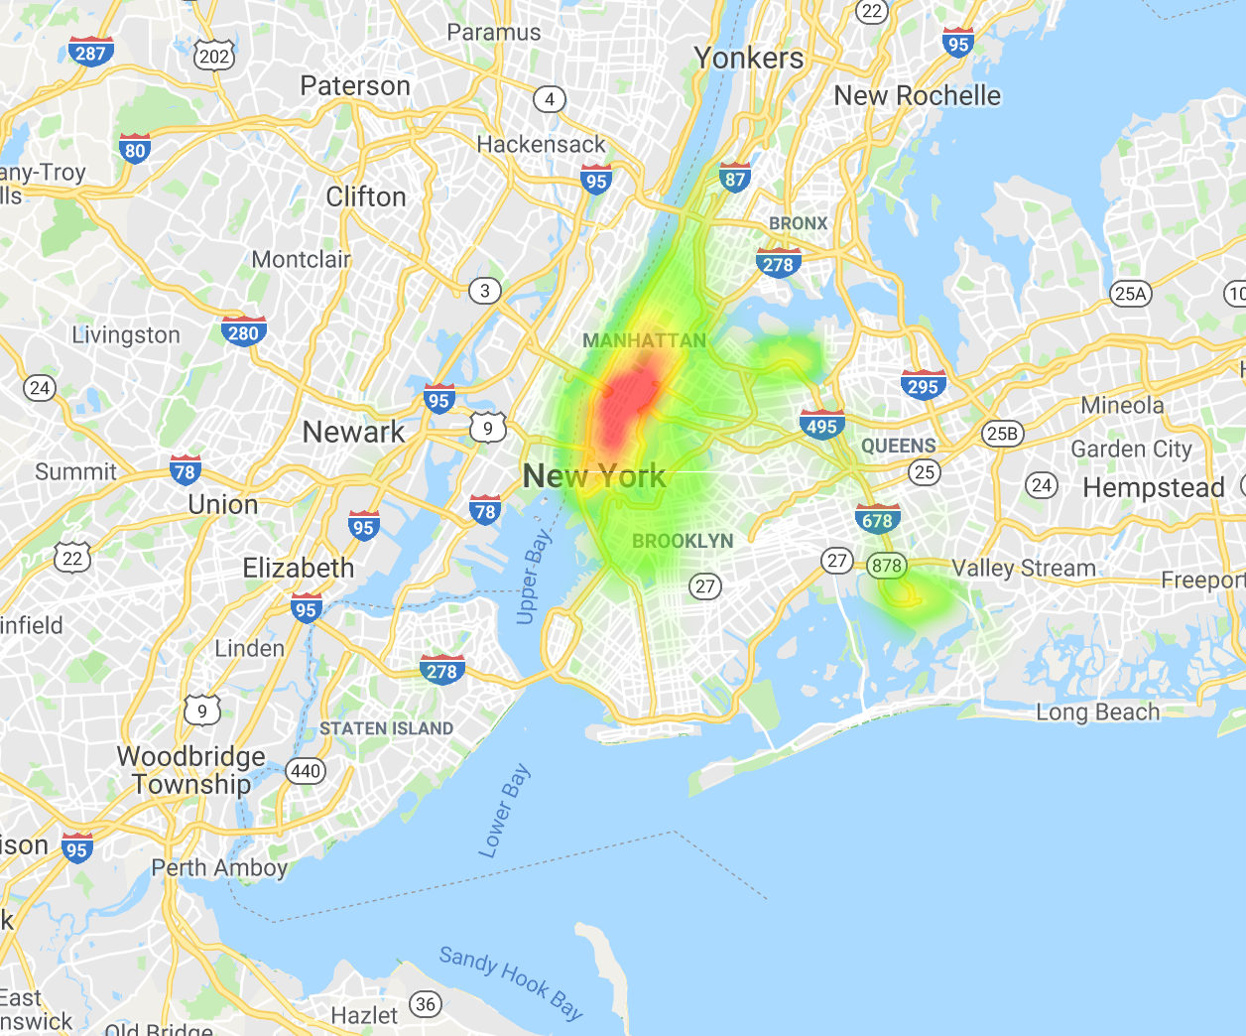
Comparison of Taxi Pickups at Different Times
6am-7am 12pm-1pm 10pm-11pm
Notes:
Weight of each heatmap spot is using root of the number of pickups
Using relative value instead of absolute value in each heatmap therefore the strongest heat color are the same for all time.

Slide 21
Summary
Ultimately achieved our realistic goal of Level 2, which includes additional predictors such as weather data.
Successfully aggregated millions of rows of trip data using Amazon Athena and combined with Weather.com API data.
Ended up not using Uber data because there were months missing and the data has the same structure as the taxi data and therefore the concept is applicable to both.
Compared numerous algorithms for their accuracy and running time and came to the conclusion that a random forest model is our best bet.
Hyperparameter tuned (100 iterations with 10 cross validations each) to gauge the expected accuracies and running time across different parameters for Random Forest.
Experimented with different visualization methods, including Python and React to interact with Google Map API.
Built a prediction API based on AWS Lambda and accessible through API Gateway

Slide 22
Lessons Learned
Realized how important the prediction speed can be for specific applications of machine learning. Our grid required 900 predictions and the API was built to predict on demand. Therefore we had to make a trade off between accuracy and speed.
Learned pros and cons of using proprietary and open-source libraries and packages. The Google Maps Heatmap limited our ability to visualize our predictions to their full potential by not allowing us to easily normalize the data across different hours.
Cloud services such as Amazon Athena are extremely powerful and convenient. We were able to process a relatively large dataset without much issue and at a low cost using SQL.
Preparing and cleaning the data for training the model is a lengthy process which has a big impact on the predictive quality of the model.

Slide 23
Q&A

